Slide 1
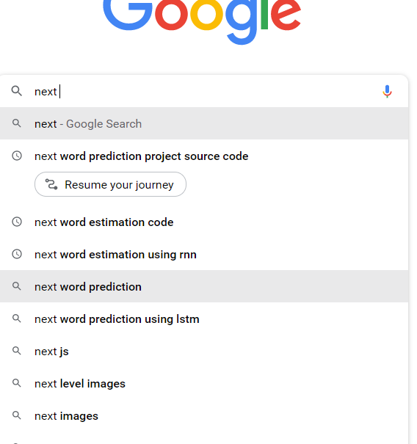
Mentor: Rajesh Bolla.
Next word estimation
Predict your next word……….
Team 68:
Pranav Chowdary.
Sai Sri Lakshmi.
Bhavana.
Deepika.

Slide 2

What is next word estimation?
Next word estimation, also known as language modeling, is a natural language processing task that involves predicting the most likely next word in a sequence of words given the previous words in the sequence.
It is a fundamental task in many NLP applications, such as speech recognition, machine translation, and text completion.
.

Slide 3




Tools used :

Slide 4

Technologies used :
1.Deep Learning :
Deep learning is a subfield of machine learning that uses artificial neural networks to model and solve complex problems. It is inspired by the structure and function of the human brain and involves training models on large datasets to learn patterns and relationships in the data.
RNN
RNN stands for Recurrent Neural Network, which is a type of neural network that is commonly used in natural language processing and other sequential data tasks.
NLP
NLP stands for Natural Language Processing, which is a subfield of artificial intelligence and computer science that focuses on enabling machines to understand, interpret, and generate human language.

Slide 5
Python has a simple and easy-to-learn syntax, making it a popular choice for beginners. It is also known for its readability and concise code structure, which makes it easy to maintain and debug
python
Flask is a popular Python web framework used for building web applications. It was first released in 2010 and has since gained popularity due to its simplicity, flexibility, and ease of use.
Flask

Slide 6
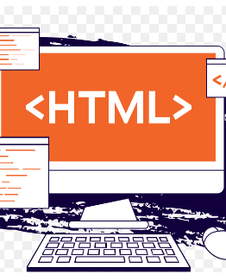
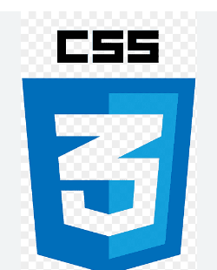
HTML and CSS
HTML and CSS are two of the core technologies used in web development. HTML is used to define the structure and content of a webpage, while CSS is used to style and format the content.
HTML is the markup language used to create the structure and content of a webpage. It consists of a series of tags and attributes that define how the content is organized on the page.
HTML tags define different elements of a webpage such as headings, paragraphs, lists, images, links, and more. HTML also provides the ability to add metadata to a webpage such as title, description, and keywords.CSS is a stylesheet language used to add style and formatting to HTML content. It allows developers to control the layout, typography, colors, and other visual elements of a webpage.
CSS works by selecting HTML elements and applying style rules to them. CSS rules consist of a selector that targets the HTML element and a set of style properties that define how the element should be styled.

Slide 7

Implementation
Collect and preprocess the data: The first step is to collect a large dataset of text and preprocess it to remove any unnecessary characters, convert the text to lowercase, and split it into sentences or smaller chunks.
Tokenize the data: Next, you need to tokenize the text into individual words or tokens so that you can create a vocabulary of all the unique words in the corpus.
Create the training data: To create the training data for the model, you need to create sequences of words where each sequence contains a fixed number of words as inputs and the next word as the output. For example, if your sequence length is 3, then your training data might look like: "the cat sat" -> "on", "cat sat on" -> "the", "sat on the" -> "mat", etc.
Build the model: There are several types of models that can be used for next word estimation, such as n-gram models, neural network-based models, or transformer models. Depending on the model you choose, you need to define the architecture, hyperparameters, and training algorithm.

Slide 8
Train the model: Once you have defined the model, you can train it on the training data using an appropriate optimization algorithm. The training process involves adjusting the model parameters to minimize the loss function, which measures the difference between the predicted and actual next words.
Evaluate the model: After training, you need to evaluate the performance of the model on a separate validation dataset to check how well it can generalize to new data. You can use metrics such as perplexity, accuracy, or F1 score to evaluate the model's performance.
Deploy the model: Finally, you can deploy the trained model to a production environment, where it can be used to generate next word predictions in real-time.

Slide 9

conclusion :
In conclusion, next word estimation is an important task in natural language processing that involves predicting the most likely word to come after a given sequence of words. This task is useful in various applications such as speech recognition, machine translation, and text completion.
Sample output:

